Slide 1




TEAM
HARIYAMA
Burcu Nur KIVRAK 181180050
Ahmet Kürşat İŞKEN 181180041
Nisa İlayda KARADUMAN 181180044
Talha Yusuf İNAN 181180040
TWITCH
ANALYSIS

Slide 2


What We Have Done
As it is known, the idea of getting rich on the internet quickly and with less effort has become very popular lately.
One of the get-rich-quick ways is to stream on the Twitch video game platform.
What should a twitch streamer pay attention to in order to gain more followers?

Slide 3

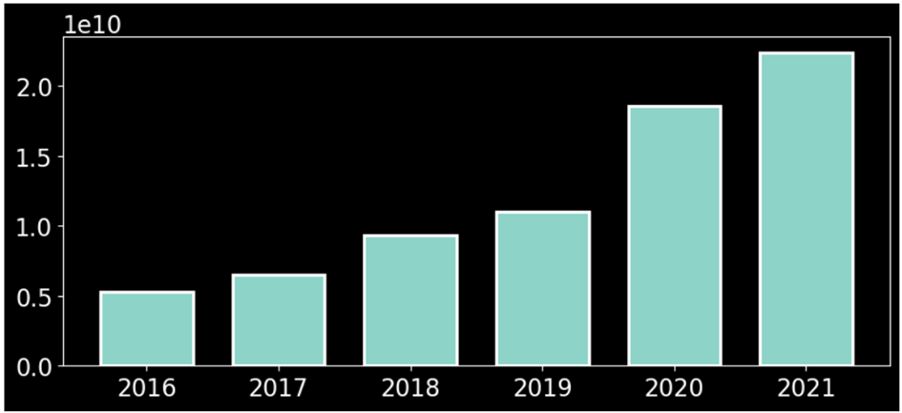
Change of viewership statistics by years

Slide 4

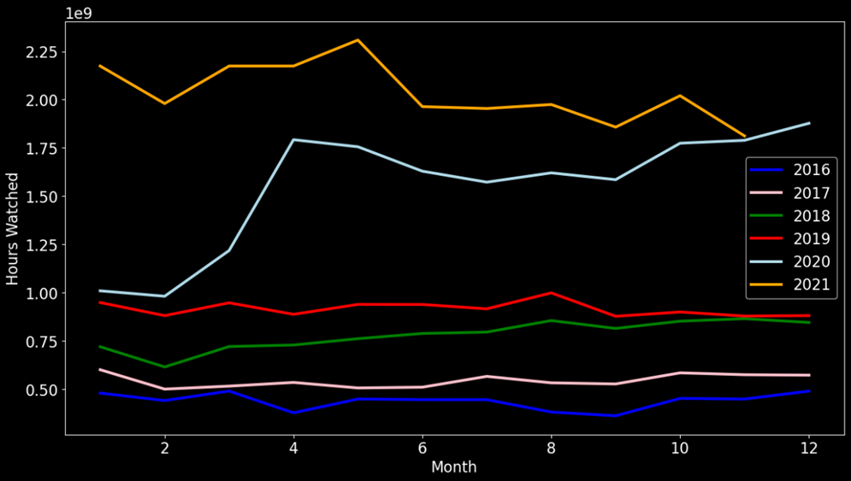
Change of viewership statistics by month

Slide 5
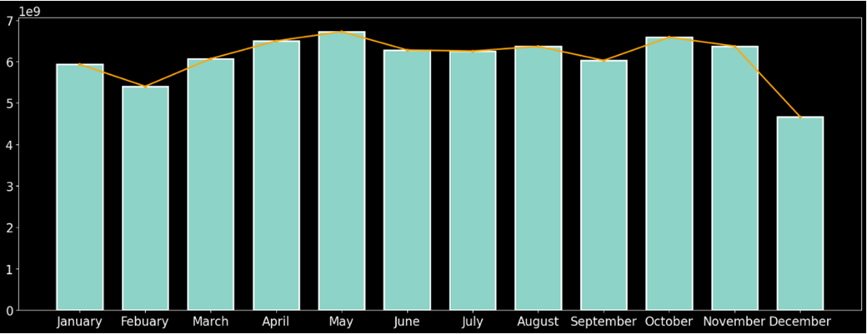

Change of average viewership statistics by month

Slide 6

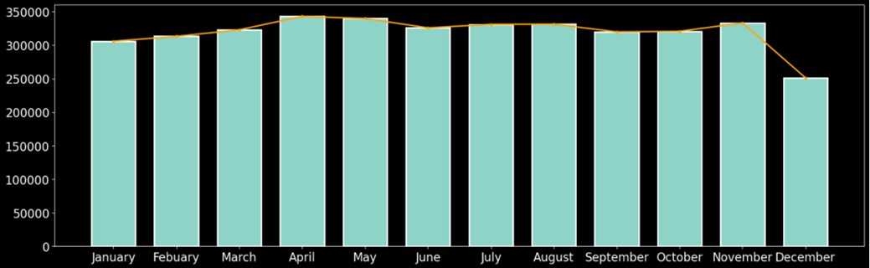
Average number of stream channels by month

Slide 7

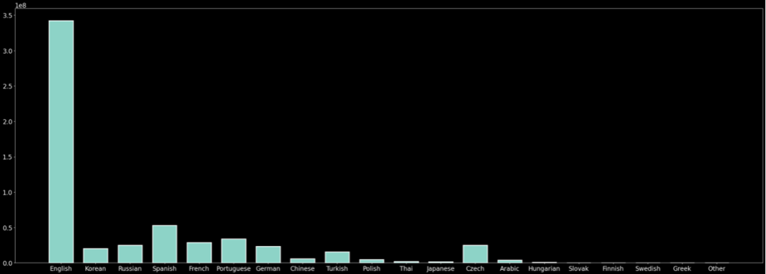
Number of followers by language

Slide 8

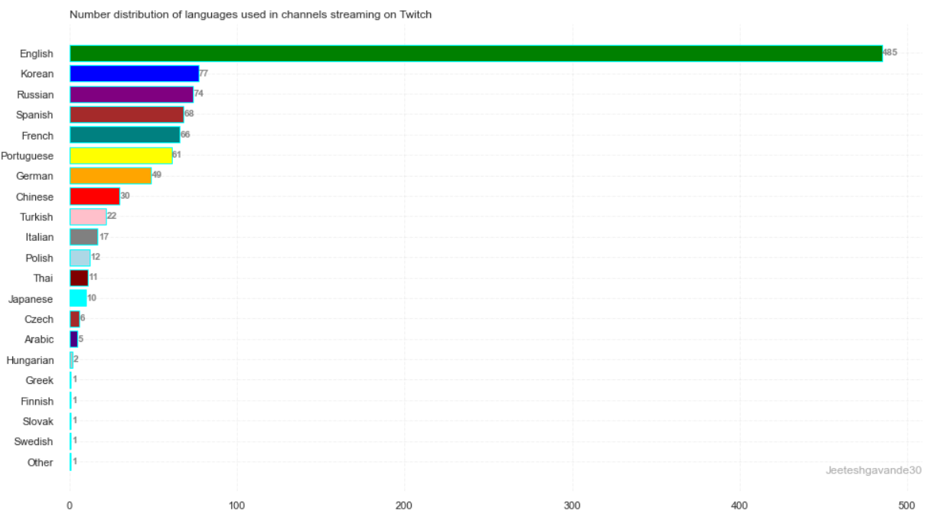
Distribution of languages ​​spoken on the streams

Slide 9
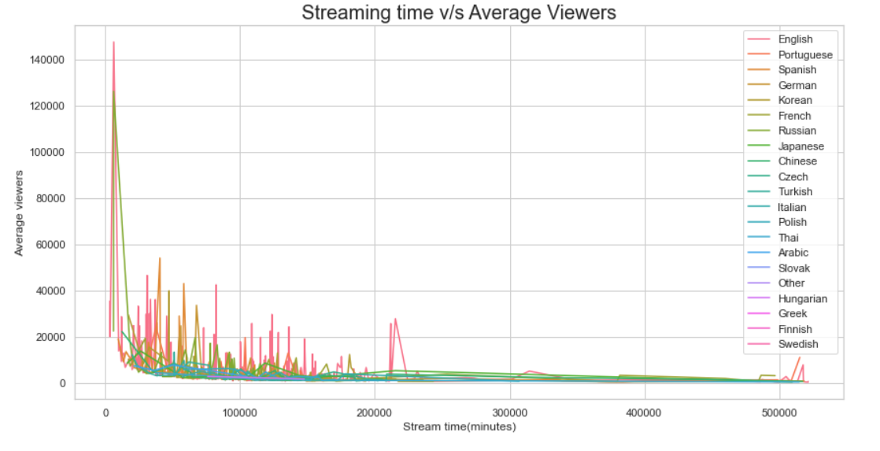
Stream Time vs Average Viewers

Slide 10

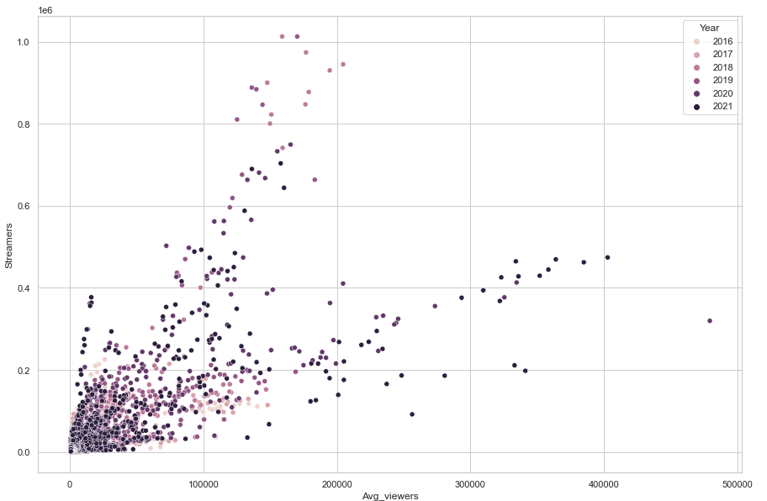
Number of viewers and streamers by year

Slide 11
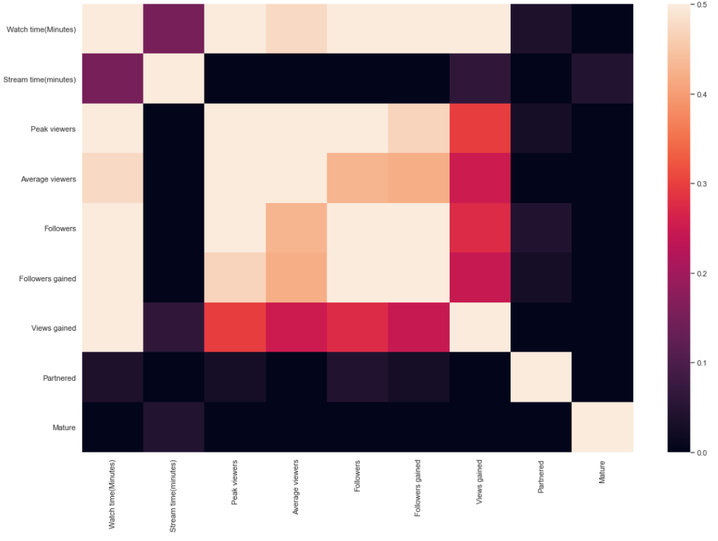

Slide 12


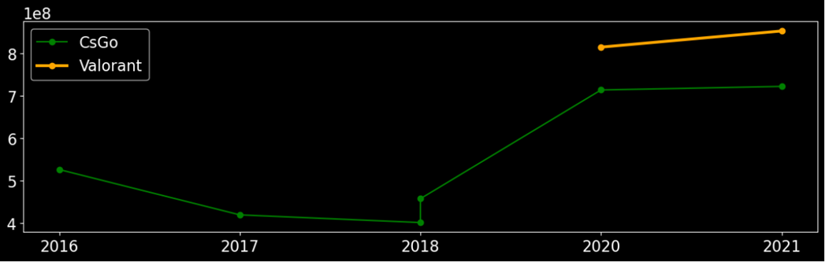
Viewership Rates of Valorant and Counter Strike: Global Offensive Games Based on Years

Slide 13


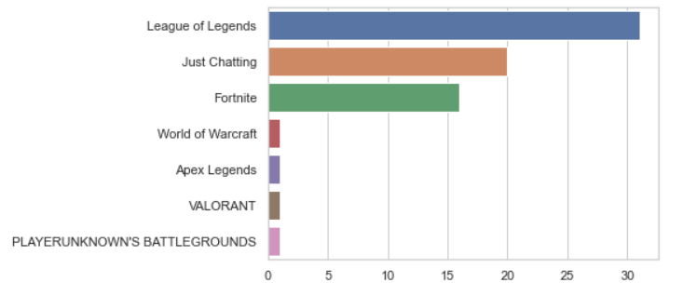
How many times some games was rank 1 before

Slide 14

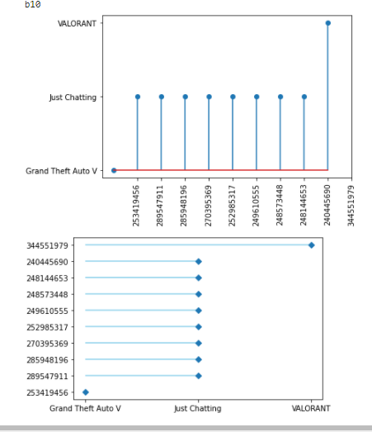
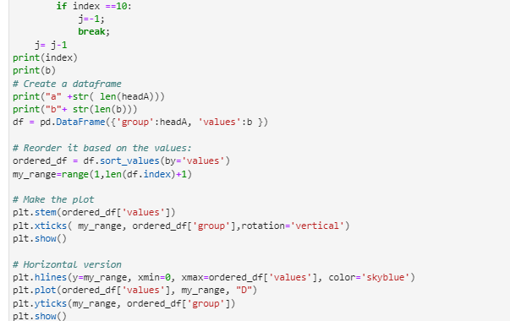
Effect of Affiliate title on follower count on Twitch

Slide 15

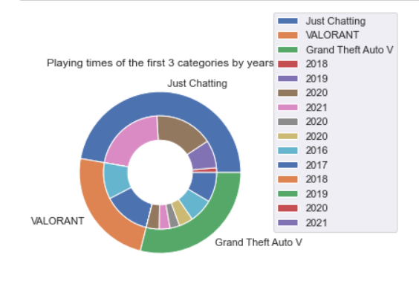
Top 3 games in Twitch
As of January 2016
Learning sessions are now conducted online in 95% of schools in the world.

Slide 16


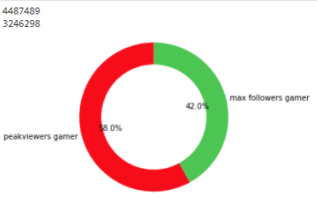
Publisher with the most followers
Comparison of the total followers of the publisher with the most peak viewers and the publisher with the most views

Slide 17

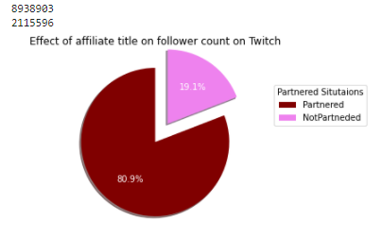
Effect of Affiliate title on follower count on Twitch

Slide 18
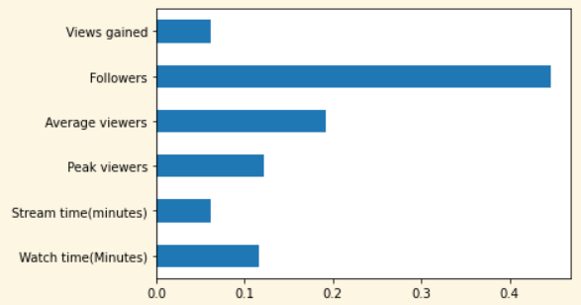
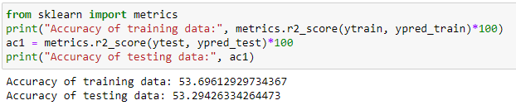
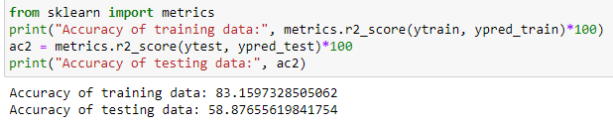
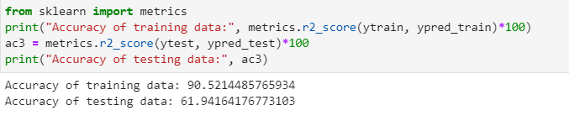
Machine Learning
Testing of Regression Algorithms
Linear Regression
Decision Tree Regressor
importance comparison between features
Random Forest Regressor

Slide 19

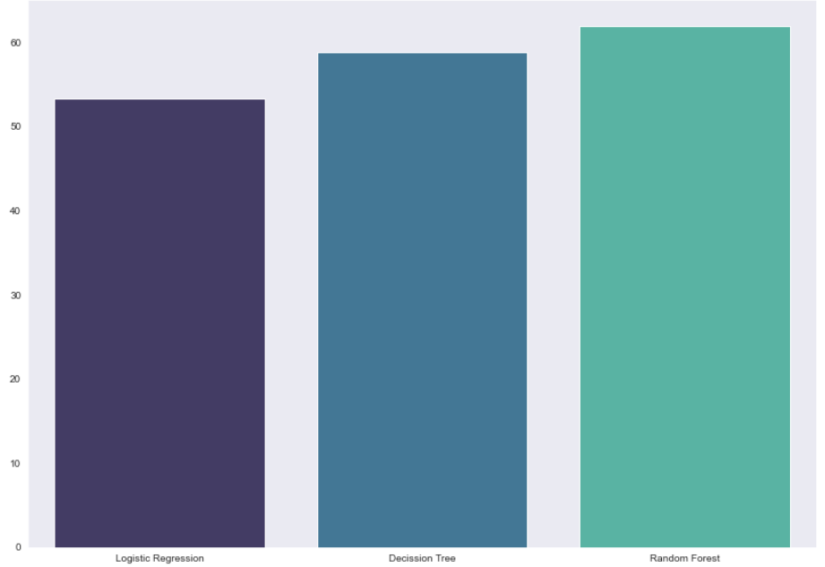
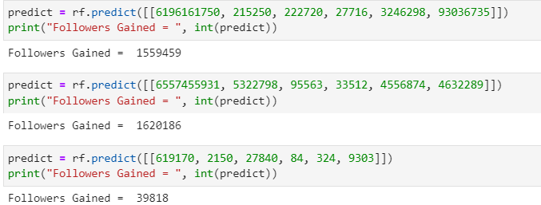
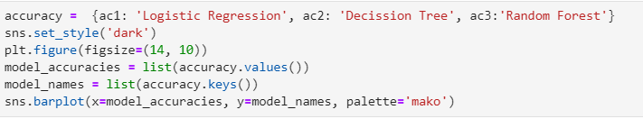
Machine Learning
What should a twitch streamer pay attention to in order to gain more followers?
Predict Samples

Slide 20

Thanks for Listening

